Slide 1
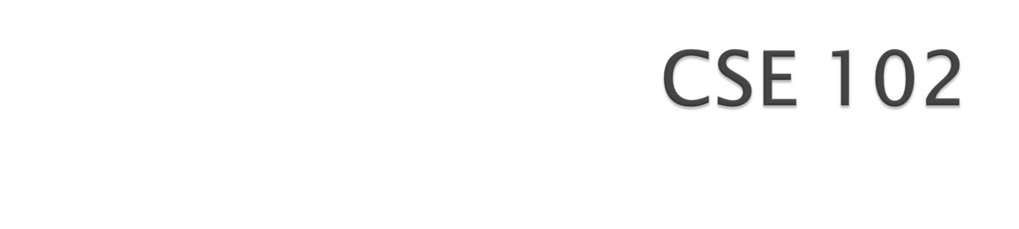
Programming Language – I Lab

Slide 2
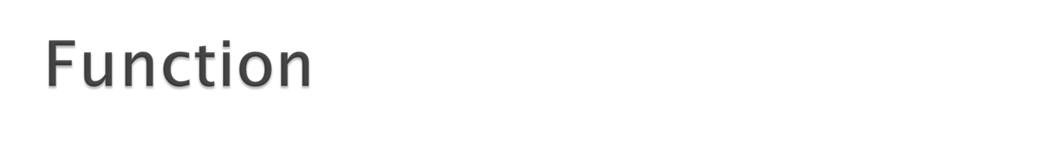
A function is a block of code that has a name.
It carries out some specific task.
Easy to write
Reduce Redundancy of code
Easy to debug

Slide 3
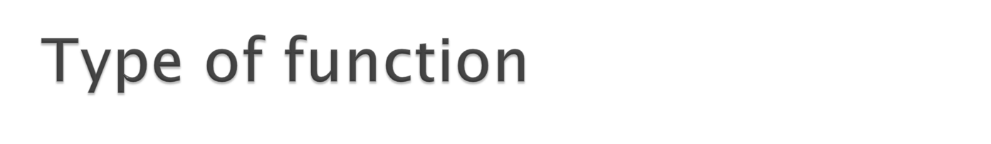
Library function
  Example :
        pow()
        log()
        sqrt()
User defined function

Slide 4
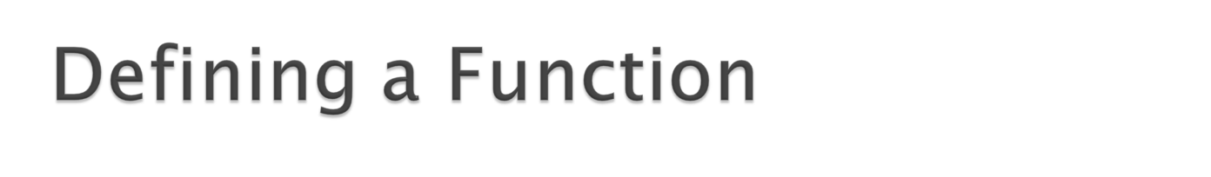
Data_type Name (type1 arg1,type2 arg2…typen argn)
Example
int sum(int x, int y)

Slide 5
void main()
{ int x,y,res ;
scanf(“%d %d”, &x, &y);
res=sum(x,y);
printf("%d",res);
}
int sum(int p, int q)
{
return p+q;
}

Slide 6
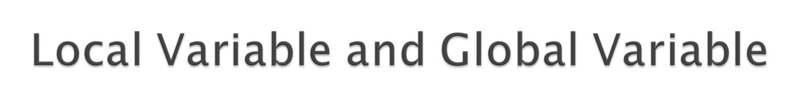
int x;
void main()
{ int x,y,res ;
scanf(“%d %d”, &x, &y);
res=sum(x,y);
printf("%d",res);
}
int sum(int p, int q)
{
return p+q;
}

